Slide 1
Special Problem
Dr. Charles Isbell
Vidhya Iyer

Slide 2
Problem Statement
To help developers learn about the features of a mobile app that they need to improve on first based on the input given by the users as reviews.

Slide 3
Program flow
The program flow can be split as follows:
RETRIEVING REVIEWS
CLEANING THE DATASET
TF-IDF VECTORIZER
CLUSTERING
TOPIC MODELLING
TOPICS COMPARISON
RANKING OF CLUSTERS

Slide 4
Retrieving Dataset using selenium
The dataset consists of information of the app such as reviews, version of the app, the rating given and the improved features for each version of the app from the time the app was introduced.
This dataset was scraped using selenium from the website www.appannie.com/‎ which is a repository of user reviews and version information on each app.
Reviews of 10 apps from the News Category(CNN, Wall Street Journal, The Hindu, ESPN etc.) were scraped over a period of three weeks.

Slide 5
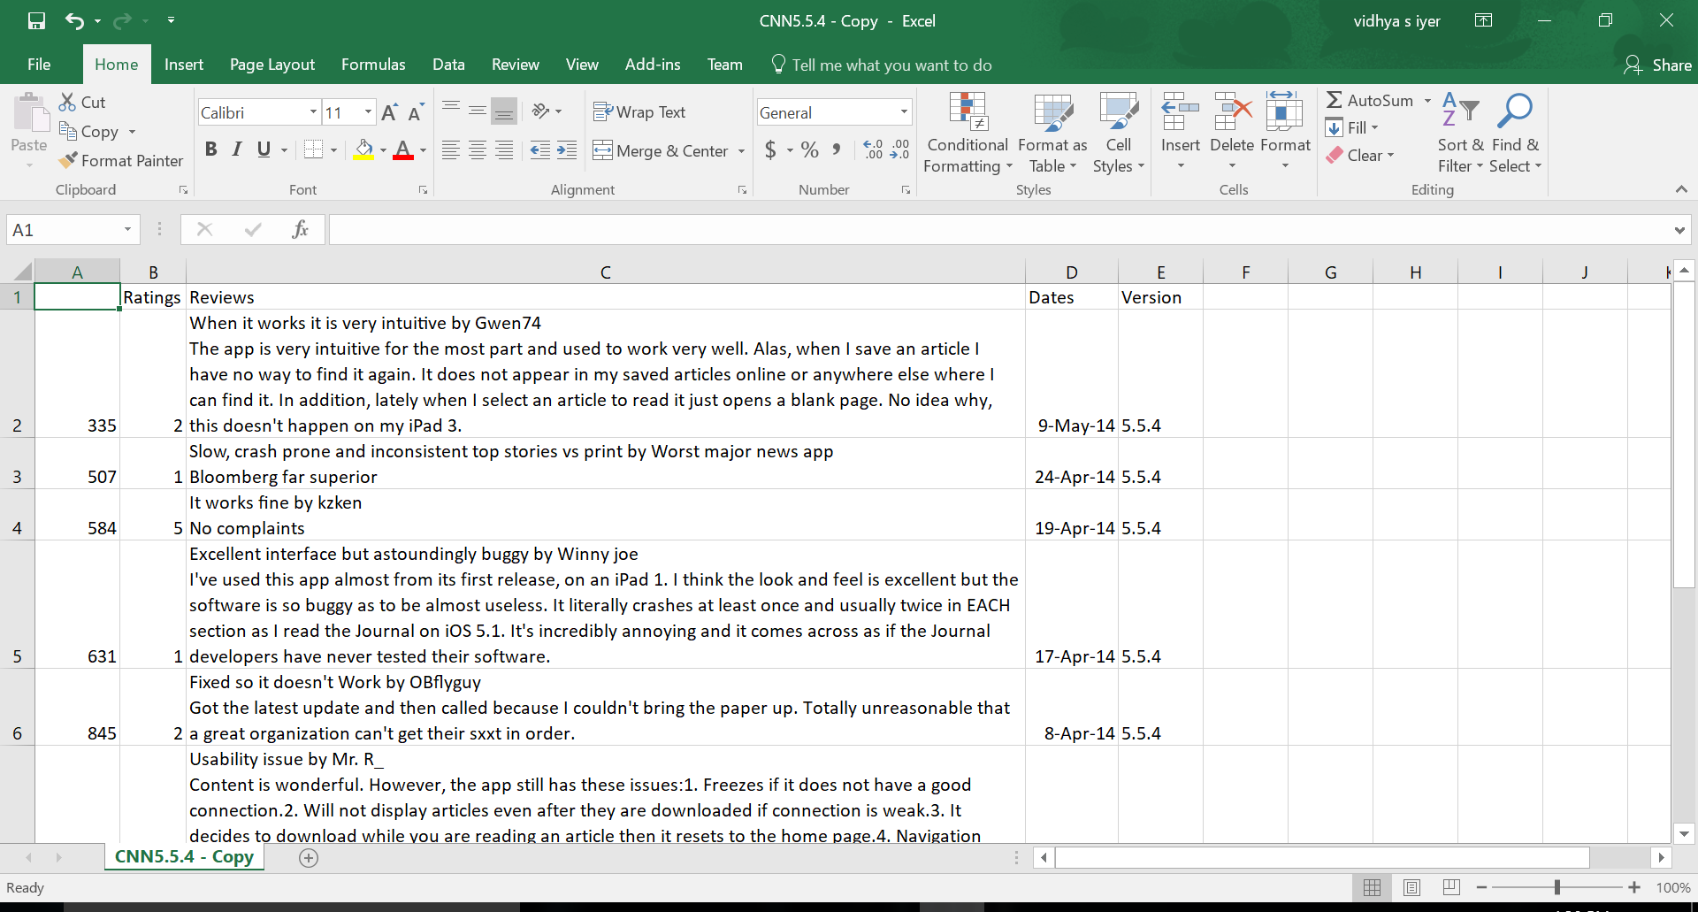
dataset
A Screenshot of the dataset is as shown here.
It contains information such as the Ratings, Reviews, Date of the User Review and Version number of the particular app.
This is stored in a csv file format.

Slide 6
CLEANING THE DATASET
Data Pre-Processing :
The pre-processing of the dataset involves :
The dataset is tokenized so that we have only the atomic elements and is converted into a list of tokens.
And this tokenization process is implemented using NLTK’s wordpunct_tokenize module.
Stop words such as conjunctions and articles are meaningless for this text analysis project and hence are removed.
And a Lemmatizer is used so we can remove the similar words and replace it with the root words
1)Tokenizing, 2)Removing Stop Words and punctuation, 3) Lemmatizing.

Slide 7
Cleaning the dataset
Examples of the pre-processing output:
Version Dataset : ['Added new sections\n']
After the preprocessing : ['added‘, 'new', 'section']
Review Dataset : [‘The worst app. The content is even bad. They publish inflammatory content written by bad, incompetent people who like to call themselves journos... The app shud be blocked.’]
After the pre-processing : ['worst', 'app', 'content', 'even', 'bad', 'publish', 'inflammatory', ‘content', 'written', 'bad', 'incompetent', 'people', 'like', 'call', 'journos', 'app', 'shud', 'blocked']

Slide 8
Bag of words
The term frequency – inverse document frequency(TF-IDF) vectorizer converts the dataset into a tf-idf matrix.
This matrix is used for the clustering of the dataset.
This matrix is seen as a weighting factor as it gives an idea of how important a word is to a document.

Slide 9
Clustering using k-means
After the pre-processing of the data, similar reviews or reviews which concentrate around the same issue or bug are clustered using K-Means clustering algorithm.
The number of clusters was decided upon using the least SSE value in a given range of ‘K’.
This clustering algorithm was chosen for the simplicity of it. It could be made better with an EM algorithm.

Slide 10
TOPIC Modelling
Topics are chosen from each cluster as a representation of what issue or topic each cluster is revolving around with.
This is done so that it would be easier to compare this information with that of the version information of the app.
Latent Dirichlet Allocation(LDA) algorithm is used for this topic modelling process to discover the topics for each cluster.

Slide 11
Topic modelling example
The topics are displayed after implementing LDA along with its probability values.
Review : ['It gets worse by Anacapaman \n Now I have to log in every time I launch the app. And I repeatedly have to delete app and reload in order to reduce its memory hogging. This is by far the worst memory hog on my iPad.']
Topics after LDA : [(0, 0.079*"app" + 0.072*"memory" + 0.054*"order" + 0.052*"hog" + 0.052*"worse" + 0.052*"hogging" + 0.052*"get" + 0.051*"repeatedly" + 0.051*"time" + 0.050*"far"'), (1, u'0.078*"memory" + 0.071*"app" + 0.053*"launch" + 0.053*"every" + 0.052*"anacapaman" + 0.051*"reduce" + 0.051*"reload" + 0.051*"worst" + 0.051*"log" + 0.050*"delete"')]

Slide 12
Topic comparison
The topics are generated for each cluster that is created from the list of reviews for a particular version of the app.
The topics are generated for each version’s update file as well so that it can be used for comparison.
The topics between each cluster data and the version updates file are compared by using the Hellinger distance metric.
This comparison helps in deciding which clusters are more significant in contributing to helping the developer identify the issue to be rectified immediately.
When the Hellinger distance between the cluster topics and version file topics is found to be greater than 0.5, that cluster is selected otherwise the cluster is discarded.

Slide 13
Topics comparison example
The topics from each cluster is compared with the version text file(version file contains the features that the developers improved on in the app) using Hellinger distance metric.
In my case, clusters which have more relation to the version topics are considered.
Comparison between Cluster topics and Version topics
version ['Fixes for other crashes should be available.']
cluster [(0, u'0.034*"app" + 0.014*"update" + 0.014*"download" + 0.012*"crash" + 0.012*"iPad" + 0.011*"work" + 0.011*"latest" + 0.009*"freeze" + 0.009*"article" + 0.009*"story"'), (1, u'0.031*"app" + 0.017*"update" + 0.016*"page" + 0.010*"story" + 0.010*"iPad" + 0.010*"article" + 0.010*"load" + 0.009*"time" + 0.009*"section" + 0.009*"sometimes"')]
topic comparison distance between version and reviews
0.74293967646

Slide 14
Ranking of clusters
Once the topics are compared, we get the sense of which clusters are more important than others.
The clusters are accordingly ranked, meaning clusters containing helpful information are considered(where the Hellinger distance was higher than 0.5) and the clusters that contain reviews that might not be useful for the developers are not considered.
These clusters contain the reviews that the app developers need to focus on to improve for the ratings to go up.

Slide 15
Cluster Ranking example.
Comparison between Cluster topics and Version topics
========
version ['Fixes for other crashes should be available.']
Cluster topics [(0, u'0.034*"app" + 0.014*"update" + 0.014*"download" + 0.012*"crash" + 0.012*"ipad" + 0.011*"work" + 0.011*"latest" + 0.009*"freeze" + 0.009*"article" + 0.009*"story"'), (1, u'0.031*"app" + 0.017*"update" + 0.016*"page" + 0.010*"story" + 0.010*"ipad" + 0.010*"article" + 0.010*"load" +
0.009*"time" + 0.009*"section" + 0.009*"sometimes"')]
0.74293967646
topic comparison distance between version and reviews

Slide 16
Cluster ranking explained
From a group of two clusters, one cluster has been selected as that cluster alone has more similarity to what is there in the version file.
The Hellinger distance as seen is 0.74293967646 which is more than 0.5.
The other cluster does not contain information that could help developers and hence is ignored.

Slide 17
Task list and timeline
The initial phase of this project involved a literature survey where relevant papers were studied.
The dataset was then downloaded over a period of three weeks using selenium.
The cleaning of the dataset and the clustering of the reviews was implemented in the next three weeks
The LDA was implemented next in two weeks and also the comparison of the topics between the version file and the review file.
Then the model has to be trained over the entire dataset and will be tested.

